Slide 1
The Liberation Contingency: A Star Wars Game
Ryan Orf and Nathan Toepke

Slide 2
Summary
Implementation of Bee Game (The Liberation Contingency)
Multiple Levels
Enemy and Environment variety
Persistent Score across Levels

Slide 3
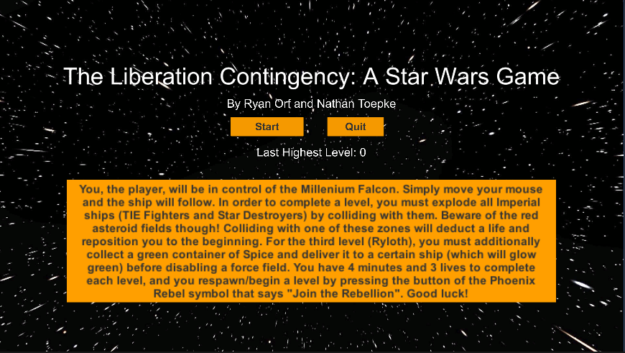
Summary of Final Design

Slide 4
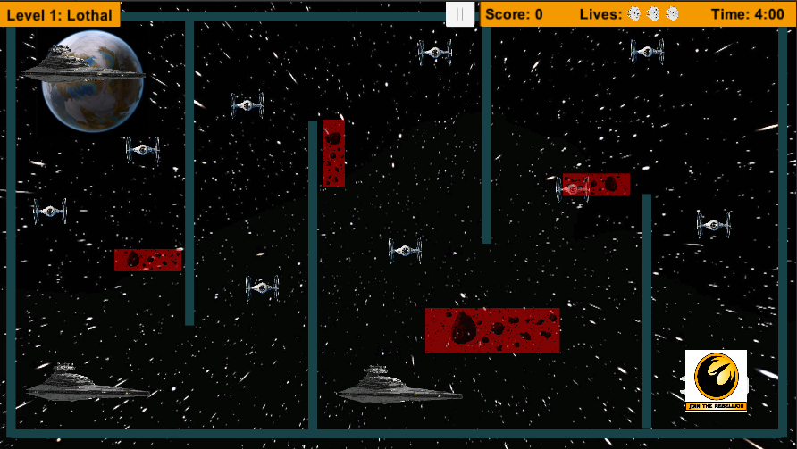
Level One

Slide 5
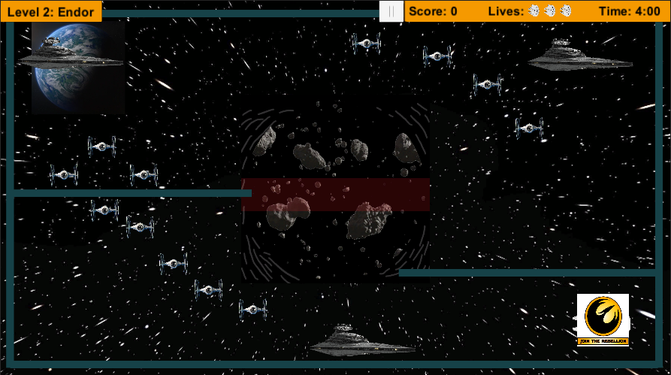
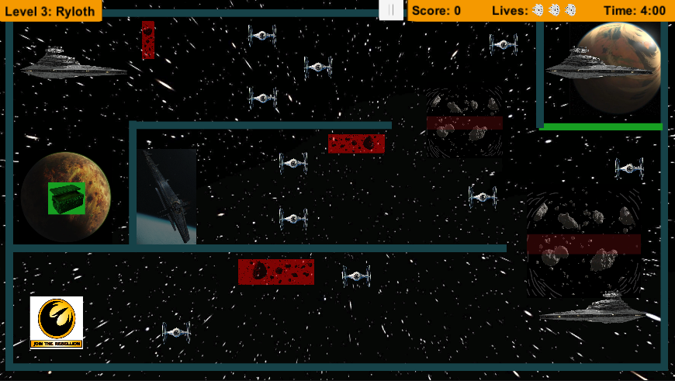
Level Two and Three

Slide 6
Implementation and Methods
Use PlayerPrefs for saving score between Scenes
Using Layers and tags to differentiate between Hero and Enemies
C# Scripting for Movement
File I/O for storing User Results
2D physics for detecting collisions

Slide 7
Implementation and Methods
Why we chose 2D
2d physics
2d collisions
More flexibility with images/sprites
Easier development for future implementation ideas
It’s a 2d game

Slide 8
Lessons Learned
2D physics and the interaction between collision meshes, box colliders, and rigid bodies
Controlling movement via script or via physics engine and forces/vector velocities
Mouse-based player control movement using Vector2.Lerp()
Basic game development difficulty, story, and level design concepts
PlasticSCM

Slide 9
Next Steps
Utilize User Feedback to improve the game
Further development for new levels
Varied Enemy scoring
Enemy that constantly pursues the player
Boss Battle?
User ship selection
Laser Firing for remote destruction
Mobile Interface

Slide 10
Team Roles and Responsibilities
Ryan: Level Design and Hero Scripting
Nathan: Enemy Scripting and Persistent Player Data
Both: UI Design Decisions and Implementations

Slide 11
Conclusion
We were able to turn this project into a very fun creation based off of something we both love. The game mechanics were simple enough to implement given what we have learned, which lent itself to no periods of severe stress or frustration. This project became so enjoyable that we currently plan to implement a couple additional features for own sake, which we may or may not have available at the allotted time of presentation.

Slide 12
Possible Sources
Star Wars Image models were obtained from Google Images
Star Wars music was downloaded from Internet Archive
We did not personally create the Star Wars images or music used in this project, and as such we are not attempting to claim them as our own or use them for any type of monetary or otherwise personal benefit.

